Slide 1

Student Management System
Python

Slide 2

How Python Runs
Source code
Byte code
.pyc file
PVM
Output

Slide 3

Student Management System
It’s a management system to manage student profile

Slide 4
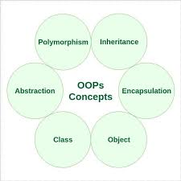
OOPS
New way of writing code

Slide 5
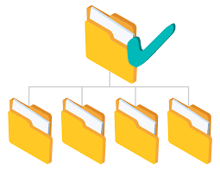
Folder Structure
For the modularity

Slide 6
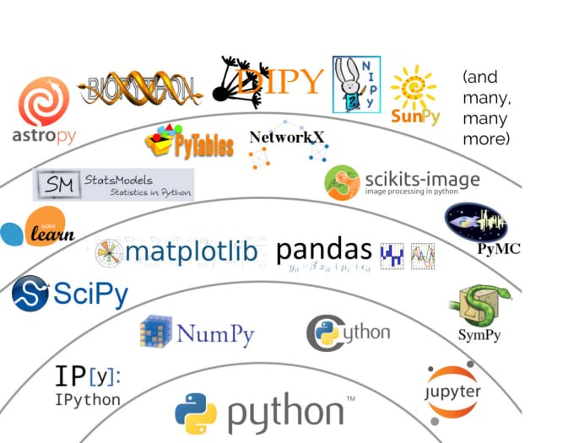
Python library
One of the reason that python is famous for.

Slide 7
Team Members
Manoj Basnet
Agaman Thapa
Abhishek Chimariya
Aashrey Amatya

Slide 8

Thank You..

